Slide 1
Front and Corner Side Yards
ATTACHMENT B
Fences permitted in front and corner side yards:
3 ft. solid; up to 4 ft. if 50% open
North Street
Front Yard
Front Yard
Front Yard
Front Yard
West Street
Front Yard
Corner Side Yard
Thoroughfare Street
1
2
3
4
Front Yard
5
6
7
8
Corner Side Yard
Front Yard
Front Yard
Front Yard
Front Yard
South Street
Along thoroughfares, only in corner side yards: 6 ft. solid with 5 ft. setback

Slide 2
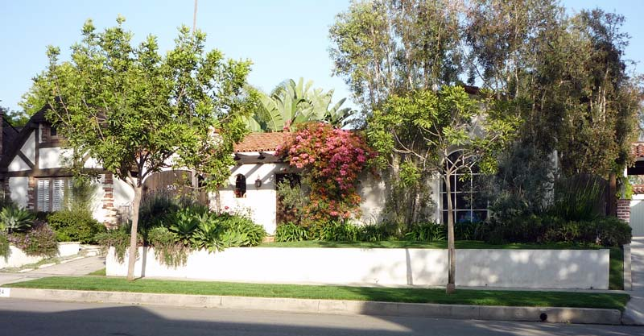
Example of less than 50% Open,
Solid Fence, Three Feet in Height

Slide 3
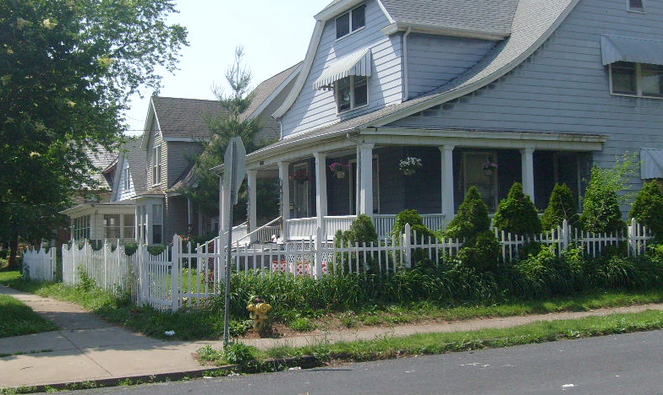
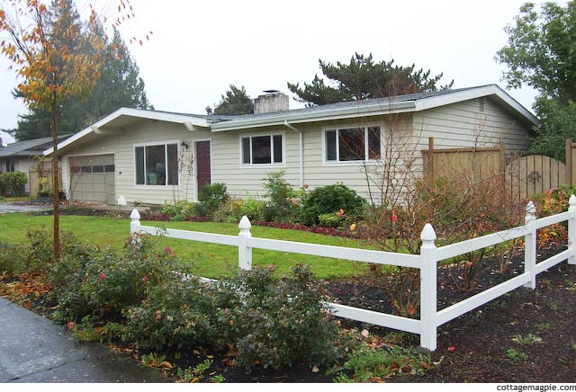
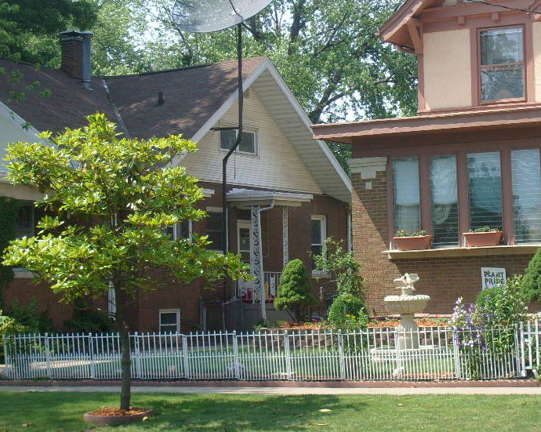
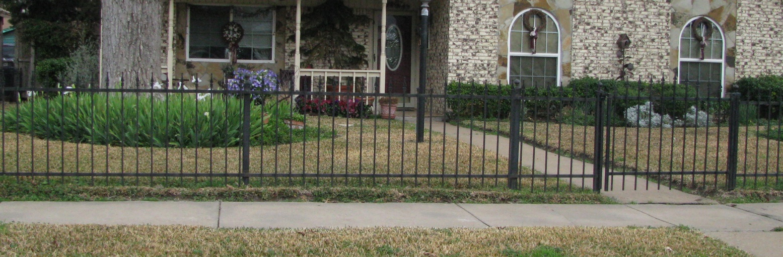
Examples of Fences 50% Open,
Up to Four Feet in Height

Slide 4
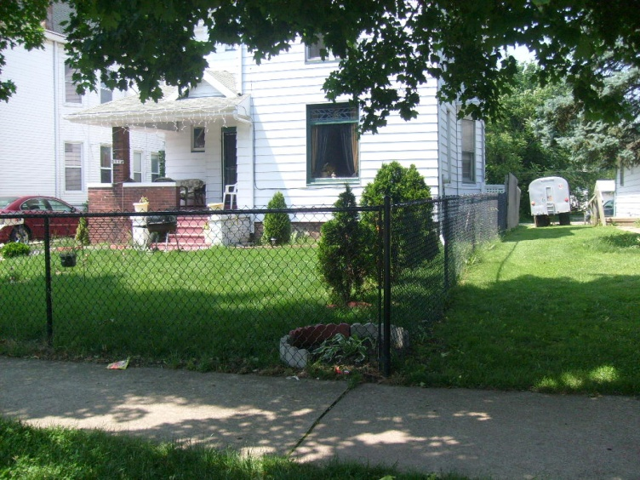
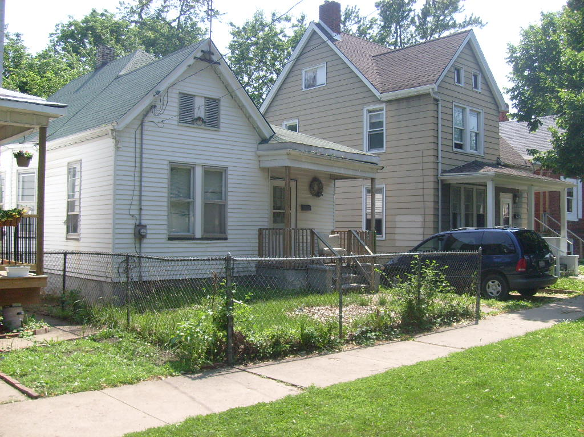
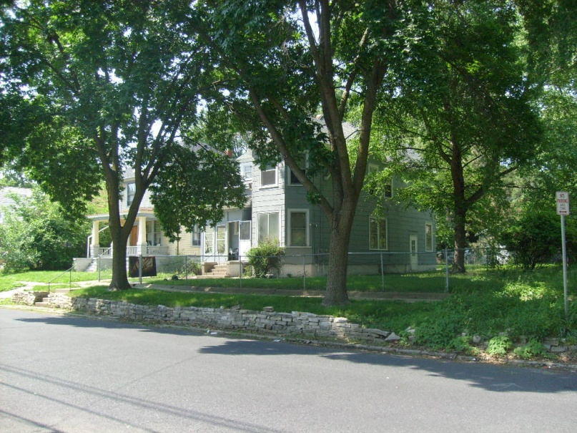
What Would No Longer Be Allowed (no chain link in front yard)

