Slide 1

City of Peoria
CDBG Public Services
2025 Report Training Session
Britt Davis
Associate Grants Coordinator
Community Development Department
grants@peoriagov.org
(309) 494-8638

Slide 2
Agenda
Grant Overview
Agreement Highlights
Documents
  Service Application Form
  Cover Letter
  Disbursement Register
Neighborly
  Quarter Reports
  New Budget Draw Process
  Annual Monitoring
Questions
Notes:
FY 2019 Federal Budget – Currently in a shutdown. HUD cannot release funding allocations until the full FY 2019 appropriation is approved. The City cannot finalize your 2019 agreements until we know our allocation due to the regulatory 15% cap on Public Service expenditures.
It is anticipated to have level funding so we budgeted for a level funding amount.

Slide 3
Grant Overview
HUD – Community Development Block Grant (CDBG)
  Public Services: 15% cap
Reimbursement only
  HUD $ should be available in summer
Report due dates (10th of month after quarter)
  April 10
  July 10
  October 10
  January 10, 2026
Notes:
FY 2019 Federal Budget – Currently in a shutdown. HUD cannot release funding allocations until the full FY 2019 appropriation is approved. The City cannot finalize your 2019 agreements until we know our allocation due to the regulatory 15% cap on Public Service expenditures.
It is anticipated to have level funding so we budgeted for a level funding amount.

Slide 4
Agreement Highlights
Effective 1/1/2025 to 12/31/2025 (pg. 2)
Staff titles (pg. 2)
Eligible expenses (pg. 3/4)
  Staff salaries, benefits, and taxes ONLY
  Admin expenses = max 5% of total budget
Keep records for 5 years (pg. 6)
No lobbying, political activities, or religious activities (pg. 11)

Slide 5
Documents
Service Application Form
Cover Letter
Disbursement Register

Slide 6
Service Application Form
Each CDBG-eligible client must complete
  CDBG-eligible = City of Peoria resident AND low-income household
Collect for # of clients listed on agreement (at least)
Information is compiled and reported quarterly
Updated form will be sent when HUD updates 2025 income guidelines
Notes:
2019 income limits have not been announced yet. Use 2018 forms until 2019 is announced. I will email out the updated forms with the effective date once the 2019 limits are announced.

Slide 7
Cover Letter
CDBG Percentage =
  % time worked on program X
  % CDBG-eligible clients
Attach documentation showing how CDBG percentage was calculated for each staff member (i.e., time allocation sheets, timesheets, etc.)
If different from the percentages listed, explain how request for reimbursement of salaries, benefits, or taxes is calculated.
Notes:
Please double check these numbers meet the logic model.

Slide 8
Cover Letter
CDBG Percentage =
  % time worked on program x % CDBG-eligible clients
EXAMPLE: Sebby spends 80% of her total work hours on XYZ Public Services Program. The program serves 40 clients, but only 20 are CDBG-eligible.
CDBG percentage =
  80% x 50% = 40%
Notes:
Please double check these numbers meet the logic model.

Slide 9
Cover Letter
Attach documentation showing how CDBG percentage was calculated for each staff member (i.e. time allocation sheets, timesheets, etc.)
If you already have an hourly timesheet format or other time allocation format, you may submit that.
If not, here are some examples:
Notes:
Please double check these numbers meet the logic model.

Slide 10
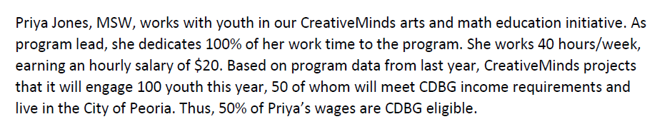
Example Time Allocations

Slide 11
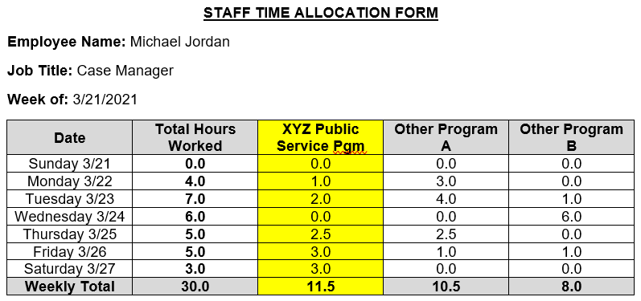
Example Time Allocations

Slide 12
Cover Letter
If different from the percentages listed, explain how request for reimbursement of salaries, benefits, or taxes is calculated.
EXAMPLE: “To calculate health insurance, ABC Agency has provided the Blue Cross/Blue Shield bill, which shows charges for each staff member. The employee’s charge is multiplied by 85% (employer-paid portion), then multiplied by employee’s CDBG percentage.”
Sebby: $450.00 x 85% x 40% = $153.00
Notes:
Please double check these numbers meet the logic model.

Slide 13
Disbursement Register
Disbursement Register by Quarter:
  A detailed list of check amounts to employees and the CDBG reimbursement request
  Can use gross pay or net pay
Reimbursement Tracker:
  Automatically populates from quarterly totals

Slide 14
Financial Backup/Proof of Expenses
Each line item on disbursement register must have financial documentation to prove the expense was paid.
  For salaries, provide copies of paychecks or detailed printouts from payroll system.
  For benefits, provide copies of invoices and proof that invoice was paid by the organization (i.e. copy of check).

Slide 15
Neighborly
portal.neighborlysoftware.com/peoriaIL/participant
Log in with email and password
  New user? Click on “Register,” then follow the prompts
Select your Public Services application
Add User

Slide 16
Neighborly
Reporting
  Accomplishments
    Only for clients NEW THIS QUARTER
    Make sure all three totals match
  Narrative (optional)
  Supporting Documents
    Cover Letter
    Staff Time Allocations
    Disbursement Register – Current Quarter
    Disbursement Register – Reimbursement Tracker
    Financial Backup/Proof of Expenses
  Submit

Slide 17
Neighborly
Budget Draws for Quarterly Reimbursements
  Budget Tab
    Once City receives HUD $, City staff will email financial reimbursements can then be submitted in Neighborly for each quarter
  Add a Draw
    Enter Request Date and Description
    Attach documentation
  Submit for approval

Slide 18
Annual Monitoring
City staff will conduct monitoring in the summer.
  Members of the CDBG Public Services Advisory Commission may attend as well.
A checklist is available online, but items to be reviewed include:
  Completed Service Application Forms
  Assessment/evaluation documentation for objectives
  Financial review, including separate accounts for CDBG funds

Slide 19
Need Help?
Email Britt at grants@peoriagov.org
Call Britt at (309) 494-8638
support@neighborlysoftware.com
https://www.peoriagov.org/205/CDBG-Public-Services

